Slide 1
The Future of Digital 2024 Report Sample Winning the New Zero Sum Game
November 2023

Slide 2
This is a small sample of the report. The full report is available to our clients.
ACCESS NOW
1 | Beyond the boom
2 | How consumers spend time
3 | How consumers spend money
4 | Converging business models
5 | Opportunities for advertisers
6 | Opportunities for retailers & brands
A G E N D A

Slide 3
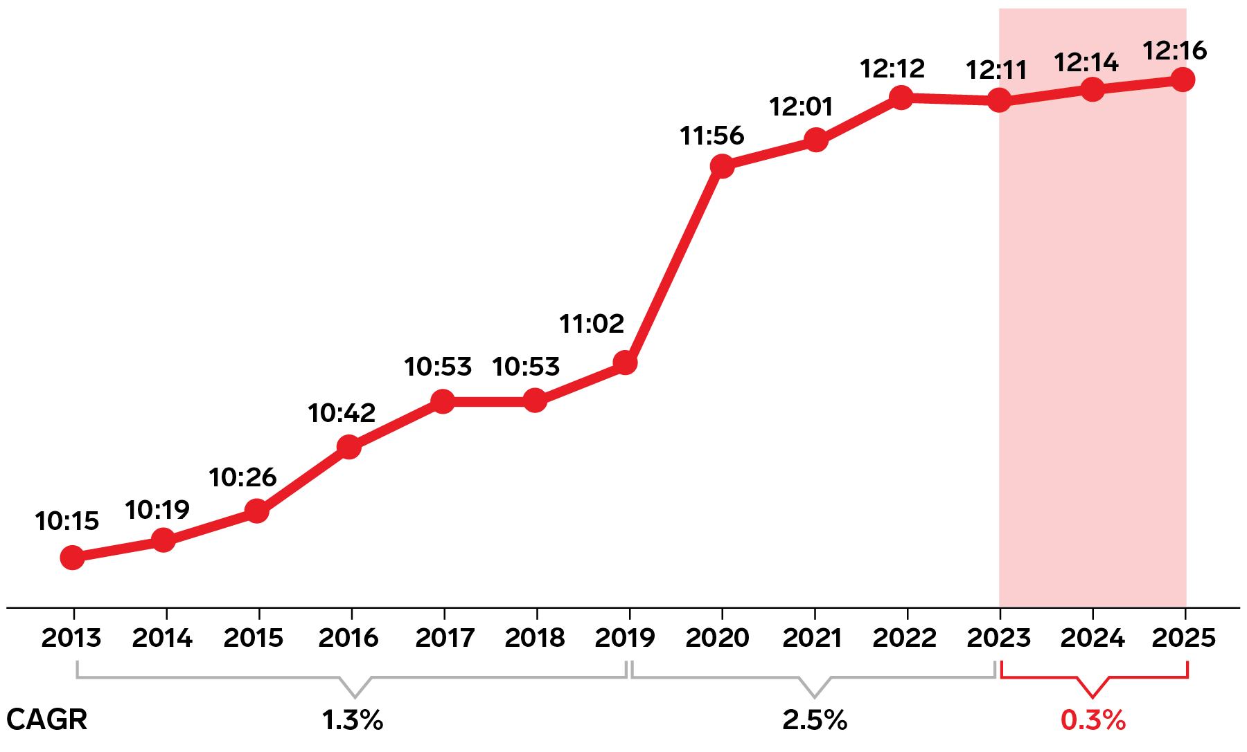
Time spent on media has reached a plateau
1 | BEYOND THE BOOM
hrs:mins spent on media per day per US adult
Note: ages 18+; includes time spent with digital internet activities (desktop/laptop, nonvoice mobile, connected TV, and other connected devices), print, radio, TV, and other traditional media including printed catalogs, direct mail, cinema, and out-of-home
Source: Insider Intelligence | eMarketer Forecast, June 2023

Slide 4
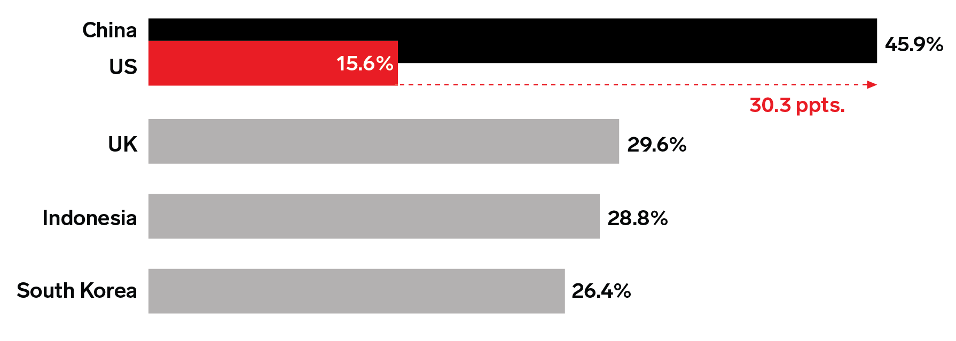
A few leading countries show that US ecommerce penetration has a lot of room to grow
3 | HOW CONSUMERS SPEND MONEY
ecommerce % of retail sales in each country, 2023
Note: includes products or services ordered using the internet, regardless of the method of payment or fulfillment; excludes travel and event tickets, payments such as bill pay, taxes, or money transfers, restaurant sales, food services and drinking place sales, gambling and other vice goods sales; China excludes Hong Kong; China, Indonesia, and South Korea forecasts from June 2023
Source: Insider Intelligence | eMarketer Forecast, Nov 2023

Slide 5
Business models are converging as big players replicate one another’s playbooks
4 | CONVERGING BUSINESS MODELS
Retail media is the latest big digital ad trend, with Amazon leading the way
TikTok is building an Amazon-like flywheel across media, advertising, and commerce
Everyone’s racing to leverage AI

Slide 6
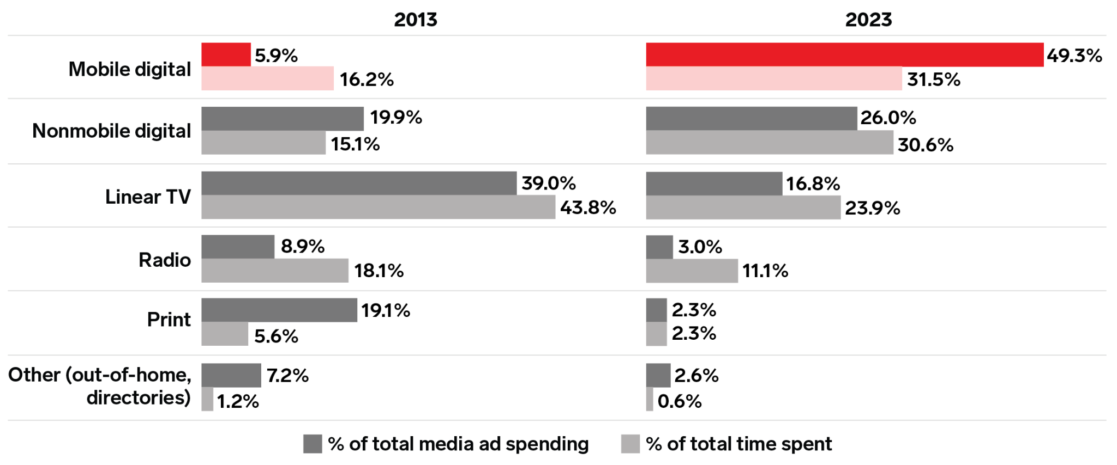
Marketers have shown they can evolve their budgets over time—but sometimes they overshoot
5 | OPPORTUNITIES FOR ADVERTISERS
% of US total media ad spending vs. adult time spent
Note: ages 18+; includes time spent with digital internet activities (desktop/laptop, nonvoice mobile, connected TV, and other connected devices), print, radio, TV, and other traditional media including printed catalogs, direct mail, cinema, and out-of-home; total media ad spending includes digital (desktop/laptop, mobile, and other internet-connected devices), directories, magazines, newspapers, out-of-home, radio, and TV
Source: Insider Intelligence | eMarketer Forecast, Oct 2023

Slide 7
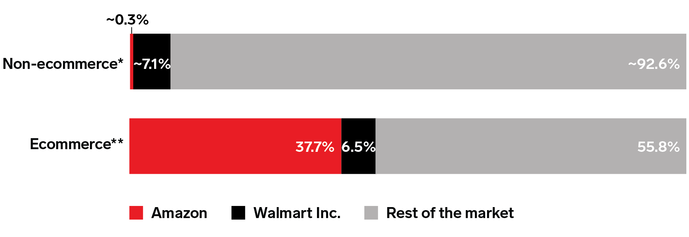
Retailers’ shift online pits them against a giant competitor that has no offline counterpart
6 | OPPORTUNITIES FOR RETAILERS & BRANDS
% of US retail ecommerce vs. non-ecommerce sales, by company, 2022
Offline, the biggest player has just ~7.1% share of the market
Note: retail excludes travel and event tickets, payments such as bill pay, taxes, or money transfers, restaurant sales, food services and drinking place sales, gambling and other vice goods sales; *non-ecommerce figures based on company earnings and are not official Insider Intelligence | eMarketer estimates; **ecommerce includes products or services ordered using the internet, regardless of the method of payment or fulfillment

Slide 8
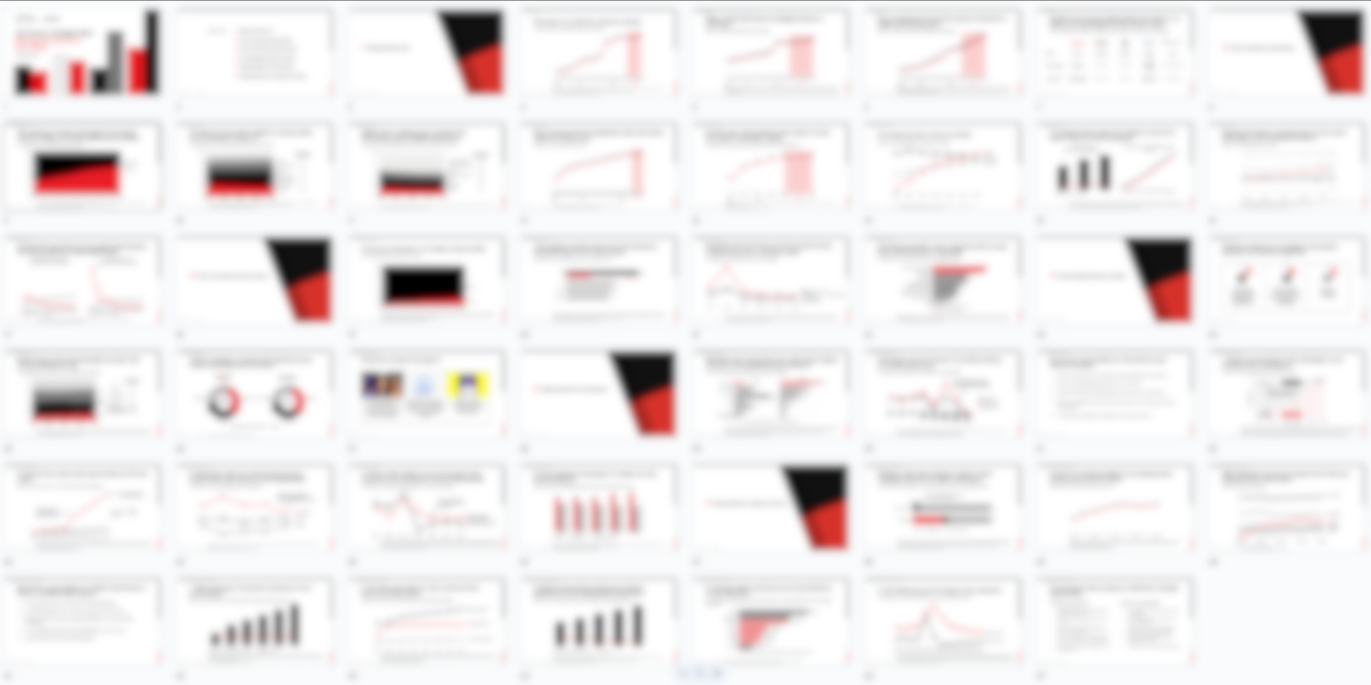
For the full 40+ slide version of the report,
become a client and get access to all our
forecasts and analysis:
SIGN UP NOW

